Slide 1


KNIGHTSBROOK HOTEL
‘ A LEADER IN SUSTAINABILITY’
PAT SMITH
B. Ag. Sc., C. Dip. A.F , C. Dir.
‘we help homes, businesses and farms reduce their energy costs and carbon emissions’

Slide 2
The Climate Change Debate!
‘ The collapse of civilization and the extension of much of the natural world were on the horizon as a result of climate change’ David Attenborough Nov. 2018
‘The concept of Global Warming was created by and for the Chinese in order to make US manufacturing non-competitive’
Donald Trump Sept 2015
‘Climate is changing but it goes back and forth, back and forth naturally’ Donald Trump Sept 2018
WHO DO YOU BELIEVE?

Slide 3

KNIGHTSBROOK HOTEL
Leading the way in becoming a ZERO carbon hotel !
Stage 1 : LED LIGHTING reduces electricity usage by 500,000kwh &carbon emissions by 250t per year
Stage 2 : SMART BUILDING controls reduce energy costs by 40,000 euro & emissions by 150t/yr
Stage 2 :SMART BUILDING controls improve site management &reduce maintenance & repair costs
Stage 3 : SMART HEATING heat pumps & heat recovery system further reducing energy & emissions
Stage 4 : RENEWABLE GENERATION with Roof top Solar PV and battery storage install
Internet of things
Wireless Technologies
Notes:
WHO ARE INTELLIGENT BUILDING MANAGEMENT SYSTEMS (iBMS)
HELP BRING SMART CONTROLS TO PROPERTY OWNERS
ENERGY EFFICIENCIES
LOWER MAINTENANCE AND REPAIRS

Slide 4
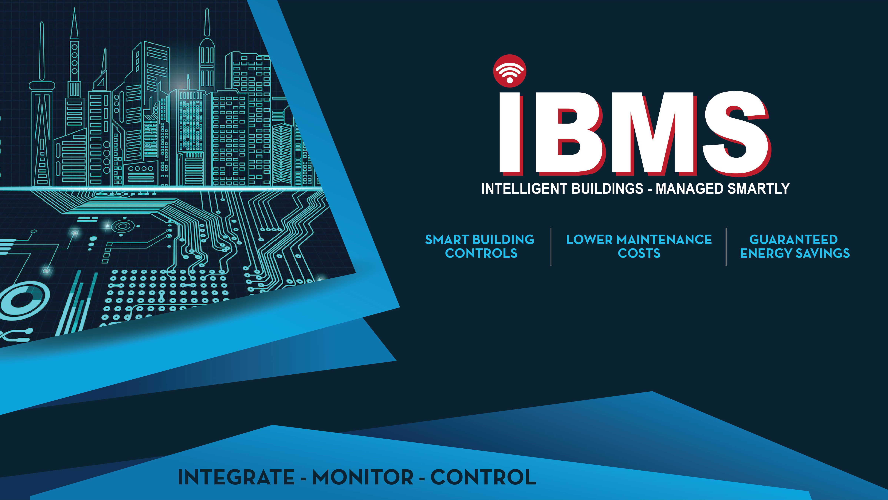

Slide 5


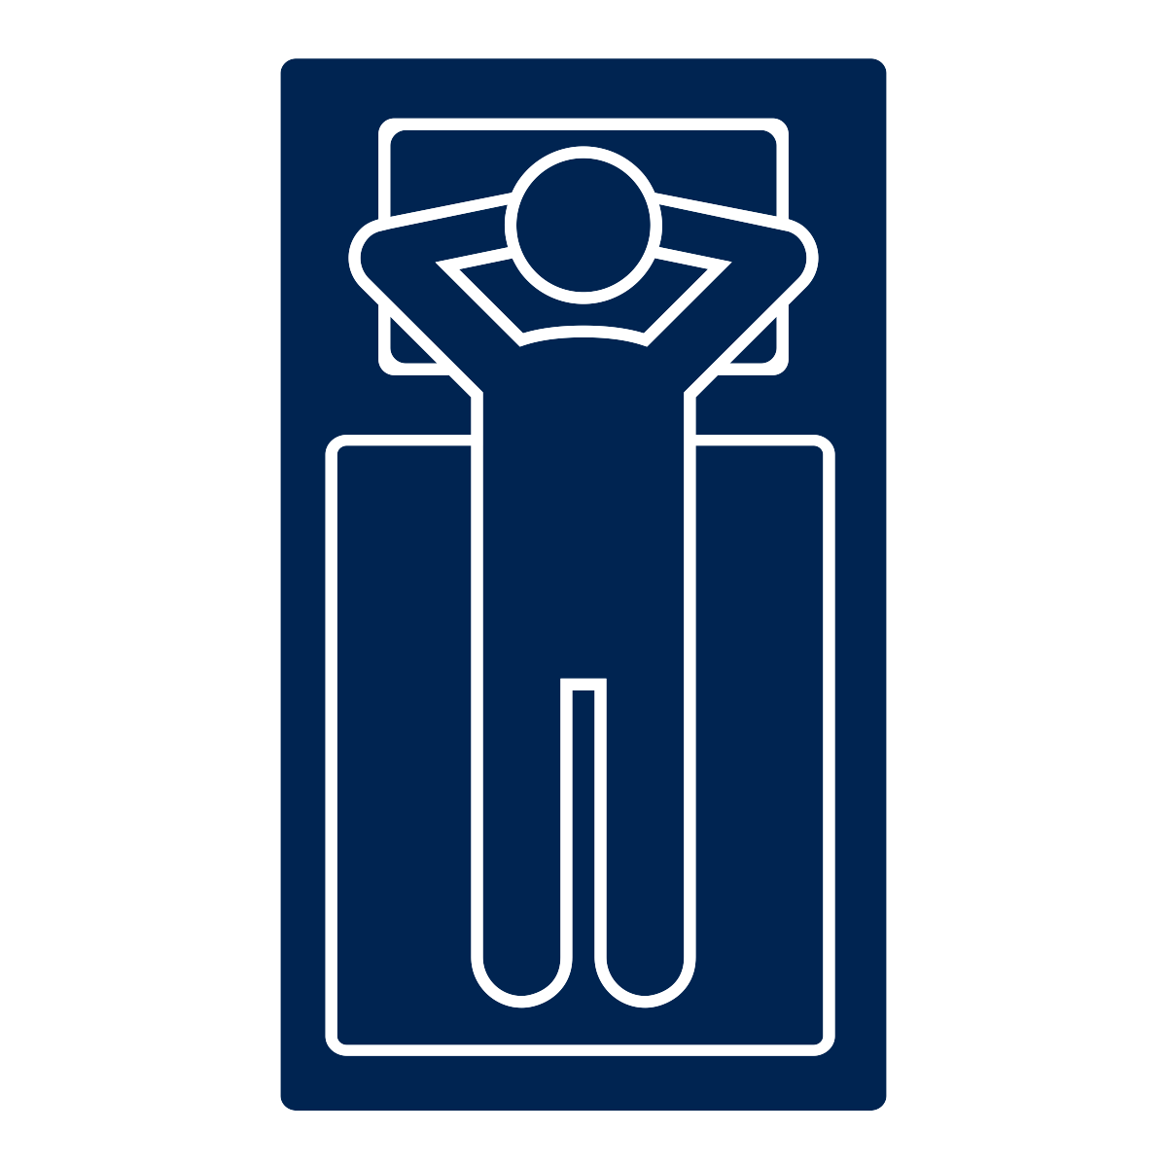

KNIGHTSBROOK HOTEL – The Drivers !
SUSTAINABILITY: by reducing energy costs and carbon emission
CUSTOMER EXPERIENCE: with better value, comfort & facilities.
BETTER CONTROL : room and utility management
BETTER MAINTENANCE : Integrated Intelligence – preventative maintenance
Notes:
WHAT ARE THE DRIVERS?
WHOLESALE ENERGY COSTS RISING THROUGHOUT THE WORLD – TOP 6 EUROPE
WE CAN’T CONTROL PRICES, BUT WE CAN CONTROL CONSUMPTION.
CONTROL GIVES INFORMATION.
PROACTIVE VERSUS REACTIVE – SCHEDULE MAINTENANCE

Slide 6
KNIGHTSBROOK HOTEL
‘ A LEADER IN SUSTAINABILITY ’
www.localpower.ie
info@localpower.ie 01 8250263
Solar PV and Battery storage systems
For homes, business and communities

